Slide 1
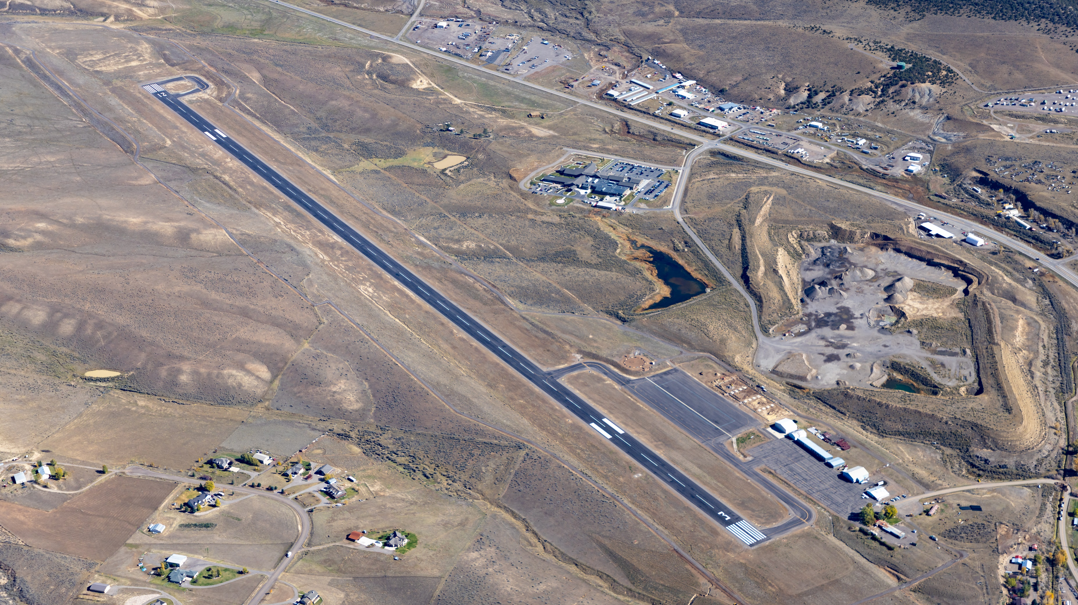



Meeker-Coulter Field (EEO)
Economic Impact Presentation
Notes:
The Colorado Division of Aeronautics partnered with Kimley-Horn to develop the 2025 Colorado Economic Impact Study (also referred to as the CEIS). The Study is an update of the previous 2020 economic impact study and quantifies the economic impacts of the 66 public-use airports throughout Colorado. This economic impact study is a tool to communicate the benefits of airports, both quantitative and qualitative, and helps justify the continued public investment in Colorado’s airport system. This presentation provides an overview of the study, including what it is, how impacts are calculated, as well as the methodology and terms used. This presentation concludes with the unveiling of study findings for our airport and total economic impacts for the entire system of Colorado airports.

Slide 2

Contents
01. What is an Economic Impact Study?
02. Economic Impacts of Meeker-Coulter Field
03. Colorado Statewide Economic Impacts
04. Additional Tools and Resources
2
Notes:
There are four key topics that I’d like to discuss with you today. First, I’ll share what an economic impact study is, then present the economic impacts of our airport, and then show the economic impacts of all public-use airports in Colorado combined. Finally, I will conclude by showcasing some additional tools and resources provided by the Colorado Department of Transportation (CDOT) for our use.

Slide 3

01
What is an Economic Impact Study?
3
Notes:
First, let’s dive into what an Economic Impact Study is...

Slide 4
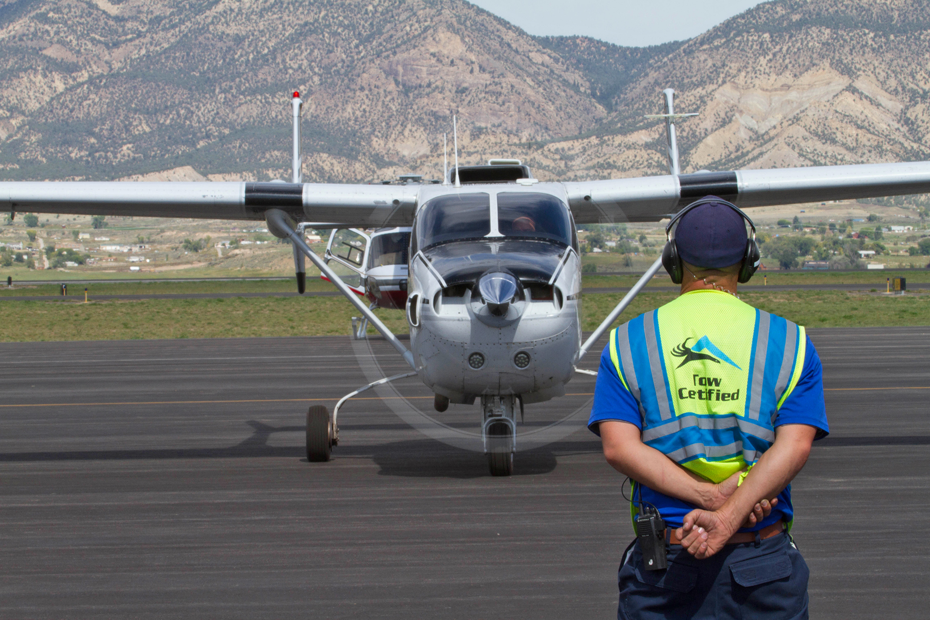
What is an Aviation Economic Impact Study?
An aviation economic impact study quantifies the economic impact associated with the state’s aviation system and other aviation-reliant or closely supportive industries
4
Notes:
As shown here, an aviation economic impact study quantifies the economic impact associated with aviation activity. For the 2025 economic impact study, CDOT captured the economic contribution of activity occurring at each public-use airport in the state individually, and then as a whole. This includes assessing the impact of things like fuel sales, business tenants, capital expenditures, and visitor spending. I’ll talk more about these sources of impact later.

Slide 5
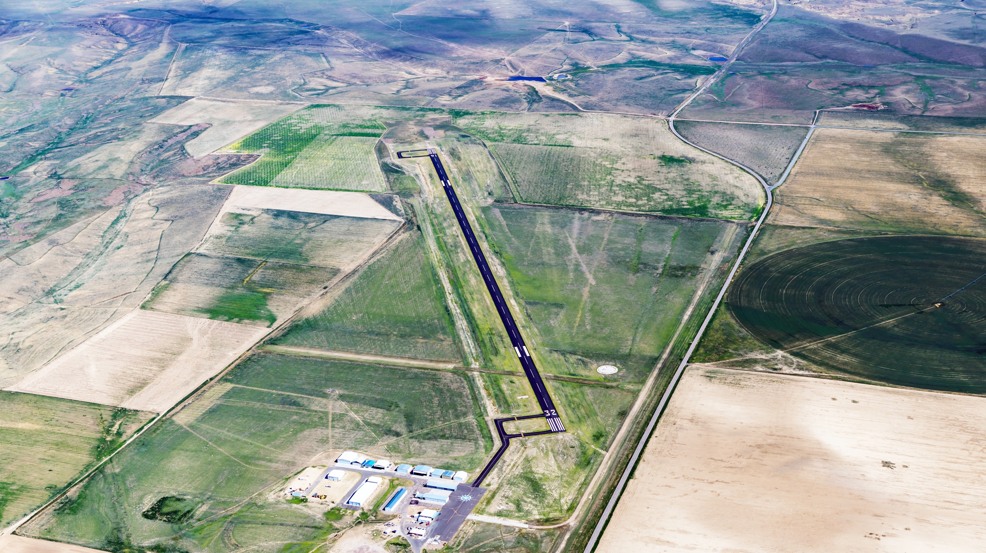




Economic Impact Measures
Jobs
Total number of people employed, both full-time and part-time.
Payroll
Total employment compensation, including wages, benefits, and taxes paid on behalf of employees.
Value Added
Total contribution to the Gross State (Regional) Product. It includes all payroll, profits, and business taxes paid
Business Revenues
Total expenditures for airport administration, capital projects and tenant sales of goods and services, as well as visitor spending in Colorado’s hospitality-related sectors. Also referred to as “output”, “sales”, or “economic activity/impact”.
5
Notes:
Economic impacts of our airport are expressed in terms of jobs, payroll, value added, and business revenues.
“Jobs” are calculated using headcount, including all full-time and part-time employees and “Payroll” as their total compensation. Payroll includes all benefits, wages, and taxes paid on behalf of the employee.
“Value Added” refers to the airport’s contribution to Colorado’s Gross State (or regional) Product. This includes payroll, profits, and taxes paid by businesses due to aviation activity in Colorado.
“Business Revenues” include payroll and value added, as well as the total expenditures for airport administration, capital improvements, and visitor spending. Business revenues are sometimes referred to alternatively as "output," "sales," or "economic activity or impact."

Slide 6







Economic Impact Categories
Direct Impacts
+
On-Airport
Impacts
Off-Airport
Visitor Spending Impacts
Multiplier Effects
Supplier Sales and
Income Re-spending
Supplier sales are portions of direct revenues used to purchase goods and services from Colorado businesses. Income re-spending reflects income earned by workers from direct and supplier sales transactions that are then spent in Colorado.
=
Total Impacts
Jobs
Payroll
Value Added
Business Revenues
6
Notes:
Although economic impact measures are not additive, the economic impact categories are. The total economic impact of airports is the sum of direct impacts and multiplier effects. Multiplier effects include both supplier sales, which are portions of revenues being used to purchase goods and services, and income re-spending, which is income earned by workers that is then spent throughout Colorado.

Slide 7
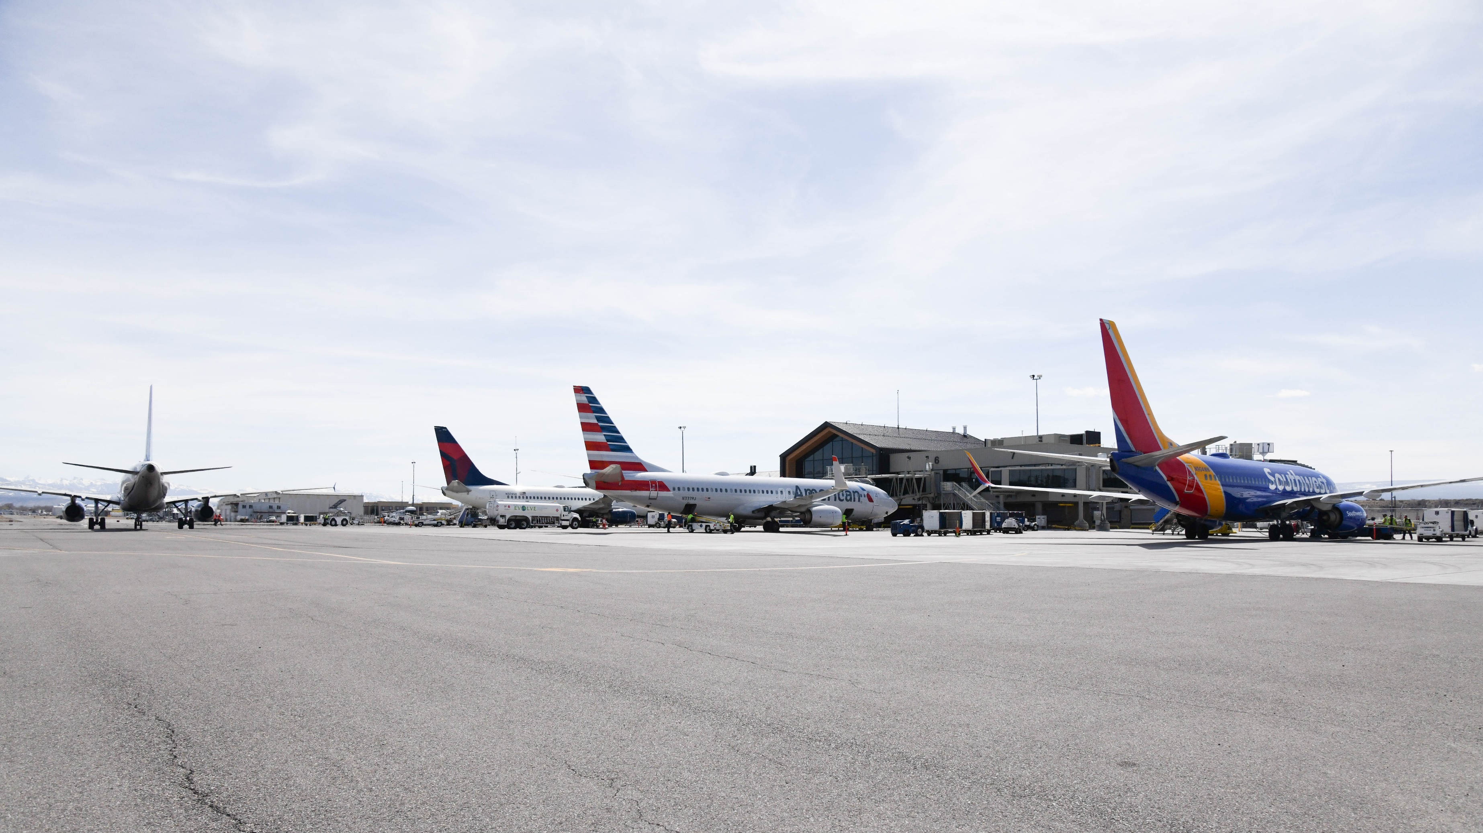
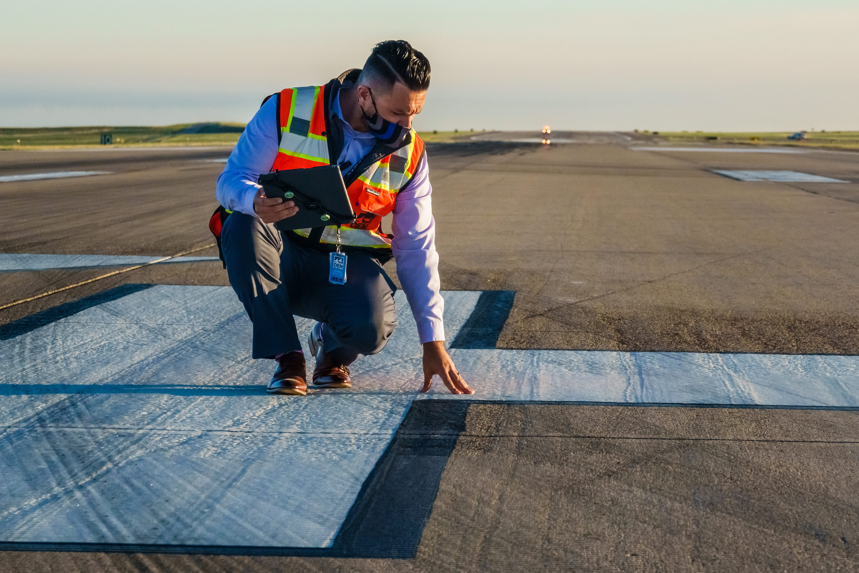
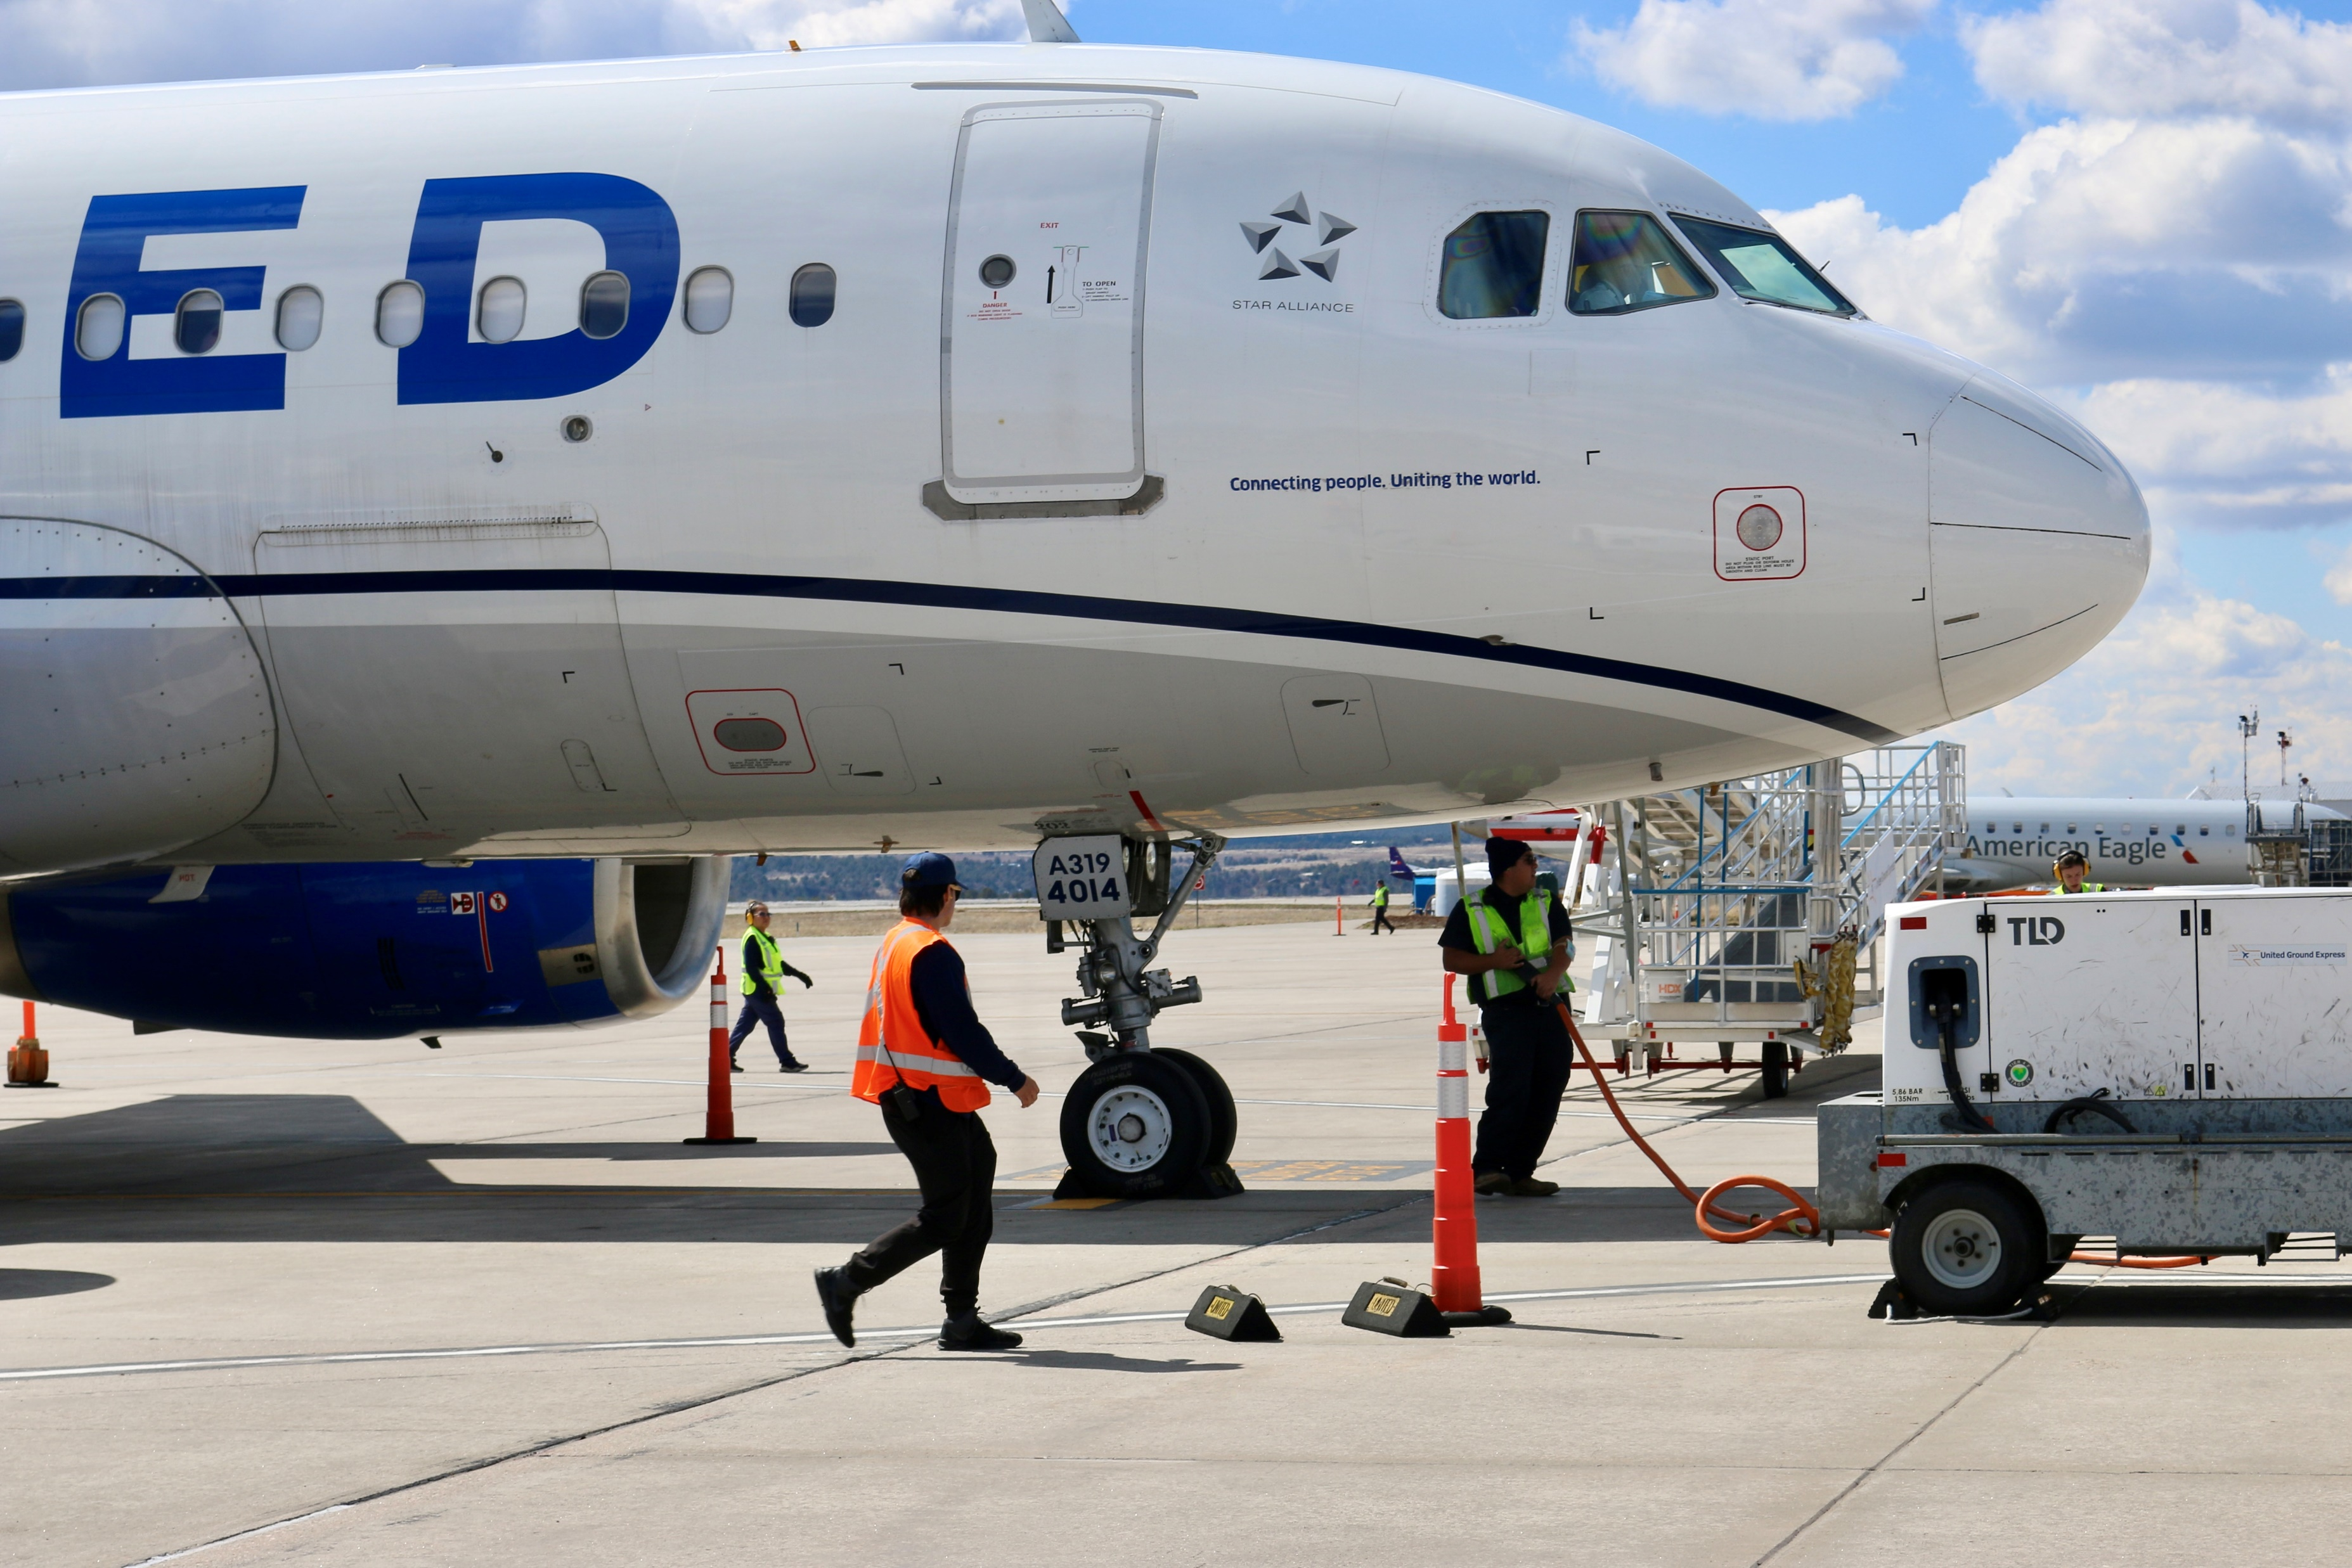
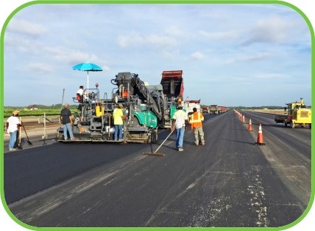


On-Airport Impacts
Airport Administration
Includes all direct airport employees, city or county employees that perform airport-related work, and contract airport employees and the payroll associated with those employees.
Airport Tenants
Includes all businesses located on airport property including aviation- and non-aviation-related businesses (airlines, fixed based operators [FBOs], terminal concessions, cargo carriers, rental car operators, etc.), and the employment and payroll associated with these businesses.
Capital Improvements
Includes annual spending on construction by airport administration and tenants, including airport (local), state, federal, and other funds.
Data collected using Airport Manager Survey administered during site visits
Four years of data (2020-2023) were gathered from Airport Manager Survey and averaged to determine the ‘typical’ expenditure year
Data collected through in-person tenant meetings and digital Airport Business Tenant Surveys
7
Notes:
There are three sources of direct impacts on our airport. The first is airport administration, which refers to the staff that operate and run our airport, including contract employees. The second is our airport business tenants who employ staff that work at their businesses on our airport. The third is capital improvements, meaning the funds that we spend (including grants from the FAA and CDOT) on improvement projects at our airport, and any capital expenditures made by our business tenants.

Slide 8


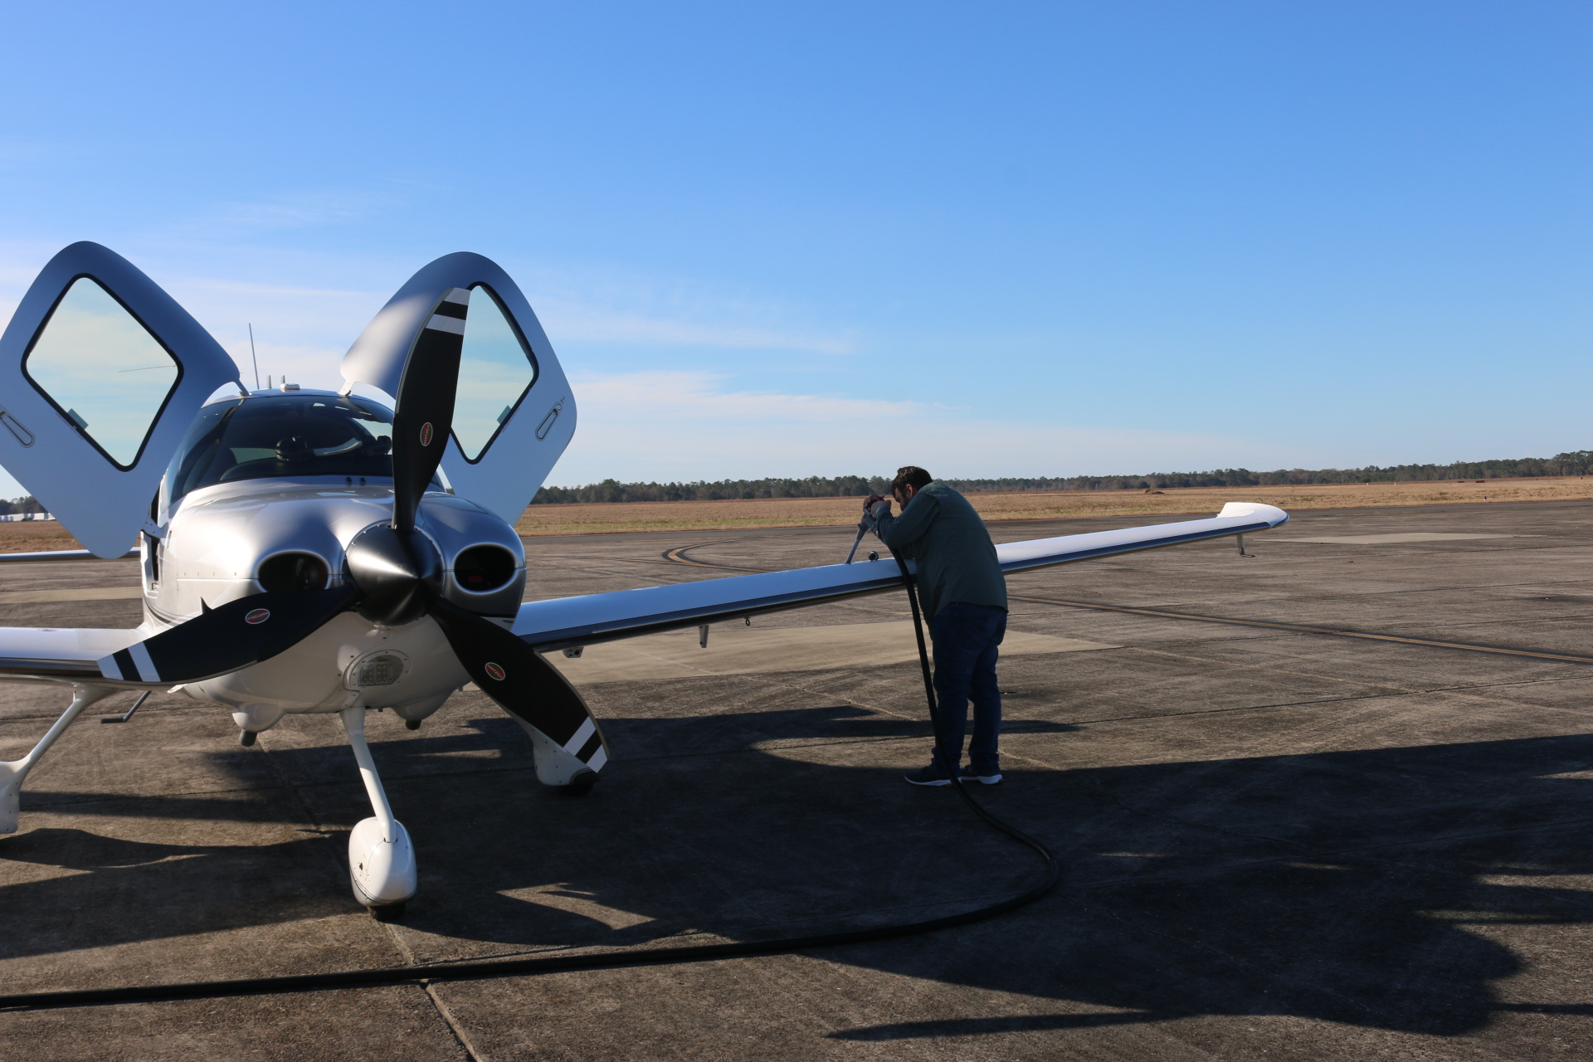


Off-Airport Visitor Spending Impacts
Commercial Visitor Spending
Accounts for the money spent in Colorado by out-of-state visitors who arrive to the state via commercial service airports
General Aviation (GA) Visitor Spending
Accounts for the money spent in Colorado by out-of-state visitors who arrive to the state via general aviation airports.
Data collected through in-person and electronic Commercial Passenger Survey using airport Wi-Fi portals
Data collected through in-person and electronic GA Passenger Survey using posters and QR codes
8
Notes:
In addition to on-airport impacts, off-airport impacts include commercial and GA visitor spending, which refers to spending within a community by out-of-state visitors who used air travel to arrive in Colorado via general aviation or commercial service. This includes spending on items such as lodging, recreational activities, and other services.

Slide 9

02
Economic Impacts of
Meeker-Coulter Field (EEO)
9
Notes:
Now that we have an initial understanding of what an economic impact study includes and how impacts are calculated, we can discuss the Economic Impact of Meeker-Coulter Field and its overall contribution to the state.

Slide 10
Meeker- Coulter Field
Total Impacts
42
Total Jobs
$1.9M
Payroll
Total Economic Impacts represent the direct and multiplier (Supplier Sales and Income Re-spending) of EEO. Impacts are communicated by the total jobs, payroll, value added, and business revenues.
$3.5M
Value Added
$6.4M
Business Revenues
10
Notes:
Overall, Meeker-Coulter Field created 42 jobs earning $1.9M in payroll, contributed $3.5M in value added, and generated $6.4M in business revenues.

Slide 11
Meeker-Coulter Field (EEO)
Total Impacts
Annual Off-Airport Visitor Spending Economic Impacts
Annual On-Airport Economic Impacts
 | Direct | Supplier Sales | Income Re-spending
Jobs | 15 | 4 | 4
Payroll | $474,000 | $274,000 | $257,000
Value Added | $913,000 | $394,000 | $482,000
Business Revenues | $2,029,000 | $769,000 | $806,000
 | Direct | Supplier Sales | Income Re-spending
Jobs | 13 | 3 | 3
Payroll | $486,000 | $208,000 | $208,000
Value Added | $990,000 | $321,000 | $390,000
Business Revenues | $1,539,000 | $610,000 | $652,000
Total Annual Economic Impacts
 | Jobs | Payroll | Value Added | Business Revenue
On-Airport Activity | 23 | $1,005,000 | $1,790,000 | $3,604,000
Visitor Spending | 20 | $902,000 | $1,701,000 | $2,801,000
Total | 42 | $1,907,000 | $3,491,000 | $6,405,000
*Totals may not sum due to rounding
11
Notes:
Let’s dive a bit deeper into those impacts by displaying the impacts of the airport within the fence and then the impacts the airport brings into the community from spending outside the airport.
*presenter to discuss individual airport impacts as represented in the tables*

Slide 12
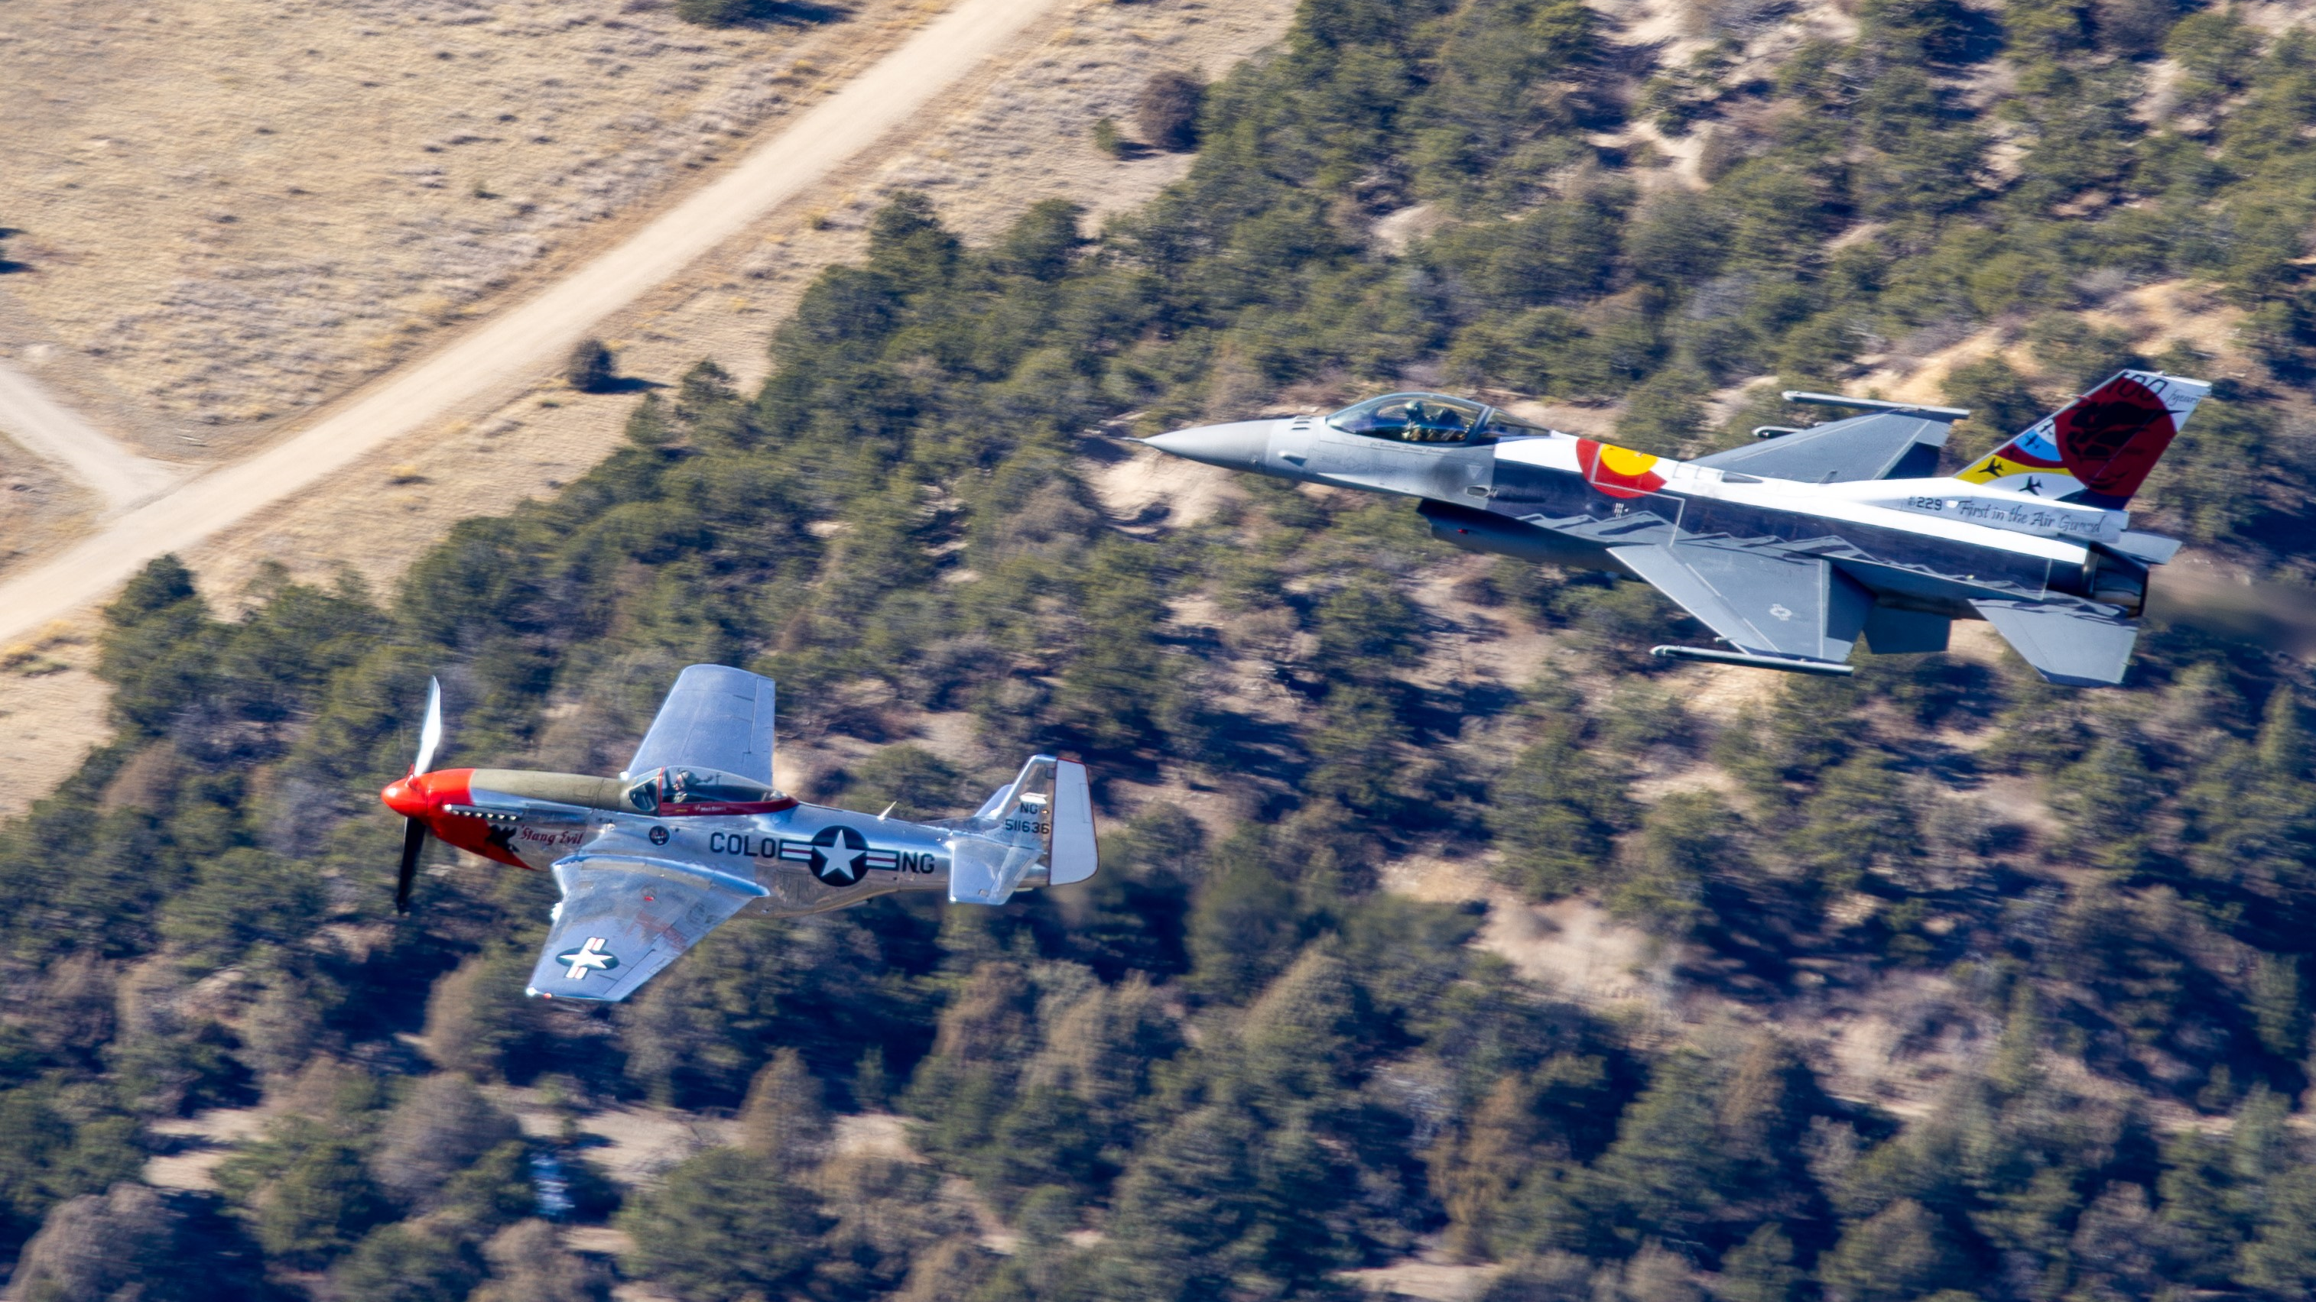
03
Colorado Statewide Impacts
12
Notes:
The following slides will discuss the total statewide impacts of aviation activity in Colorado.

Slide 13

Total Statewide Impacts
348,466
Total Jobs
$23.5B
Payroll
$40.3B
Value Added
$68.9B
Business Revenues
Statewide impacts consist of the total on-airport and visitor spending impacts of the 66 airports in Colorado, as well as the economic impacts of off-airport cargo activity in the State
13
Notes:
Statewide impact numbers are determined by adding the totals of all direct and multiplier impacts (such as supplier sales and income re-spending) from the 66 airports included in the study. Economic impact at the statewide level experienced a significant increase compared to 2020. Currently, Colorado’s airports contribute 348,466 jobs, $23.5 Billion in payroll, $40.3 Billion in value added, and $68.9 Billion in business revenues to Colorado’s economy.

Slide 14

04
Additional Tools and Resources
14
Notes:
Finally, we will discuss the additional resources and tools that were created throughout the 2025 economic impact study.

Slide 15

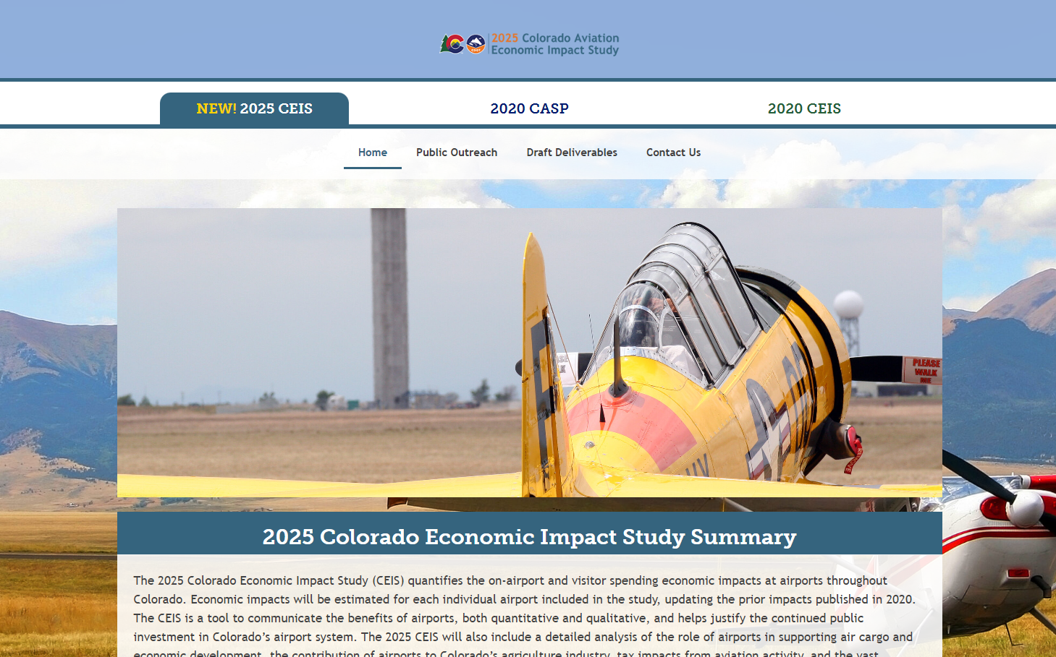
2025 CEIS Project Website
The project website is the place where you can find materials and deliverables documenting the impacts of Colorado’s 66 public-use airports, including:
Individual Airport Brochures
Individual Airport PowerPoints
Animated Flight Maps
Statewide Executive Summary
Statewide Fact Sheet
Statewide Technical Report
www.ColoradoAviationSystem.com
15
Notes:
CDOT developed a project website where you can go to access the deliverables associated with the study!

Slide 16



Thank You!
Visit our Project Website at
www.coloradoaviationsystem.com
Contact Us!
Scott Storie
CDOT Division of Aeronautics
Project Manager
303.512.5251
Scott.Storie@state.co.us
[NAME]
[Title]
[phone number]
[email address]
16
Notes:
Please reach out to me or Scott Store of CDOT directly if you have any questions related to the project!

