Slide 1
<Airport Name> Economic Impact Presentation
<Insert Date>
Notes:
The Colorado Department of Transportation (CDOT) Division of Aeronautics teamed with Kimley-Horn, EBP US (formerly Economic Development Research Group), and KRAMER aerotek to develop the Colorado Aviation Economic Impact Study (CEIS).

Slide 2
What is an Airport Economic Impact Study?
Conveys the economic importance of airports and tells the story of how airports support and enhance the Colorado economy
2
Notes:
This study quantified the economic contributions of aviation to individual airports, regions, and statewide; summarized the benefits that airports provide to residents and businesses; and gathered stories about unique aviation activities occurring across the state. Together, the analyses of the Colorado CEIS provide a comprehensive assessment on the role and benefits of Colorado’s airports, both in terms of numbers and telling the stories of the wide diversity of contributions that airports make to Colorado.

Slide 3
Primary Objectives
Identify
On- & Off- Airport Businesses
Aviation-related Industries
Calculate
Total Jobs
Labor Income
Quantify Qualify
Net Economic Contributions
Quality of Life Benefits
Business Revenues
Value Added
Tax Revenues
Visitor Spending Patterns
Notes:
The primary objectives of the CEIS were to identify the key components of aviation-related economic impacts, calculate impacts using the IMPLAN economic modeling software, and quantify the economic impacts of the Colorado aviation system. This study evaluated quantitative data in terms of net economic contributions and gathered stories from across the state about how residents, businesses, and other stakeholders are benefiting from the services that aviation provides, especially those that contribute to the quality of life of Coloradans.

Slide 4
Study Airports
Notes:
The CEIS studied 70 public-use airports across the state including:
65 publicly-owned
5 privately-owned
Of these 70 airports, 14 are Commercial Service and 56 are General Aviation (GA).

Slide 5
Overview of Analyses
Conduct quantitative data analysis
2018 serves as base year
Report airports’ economic impacts at airport, regional, and statewide levels
5
Notes:
This study started with quantifying the economic contributions of aviation to the state and summarized the benefits that airports provide throughout Colorado. Data were gathered for base year 2018, although additional information was obtained throughout 2019 and the study’s analysis was complete by the end of 2019. Economic impacts were determined for each individual airport and summarized based on OEDIT regions as well as on the statewide level.

Slide 6
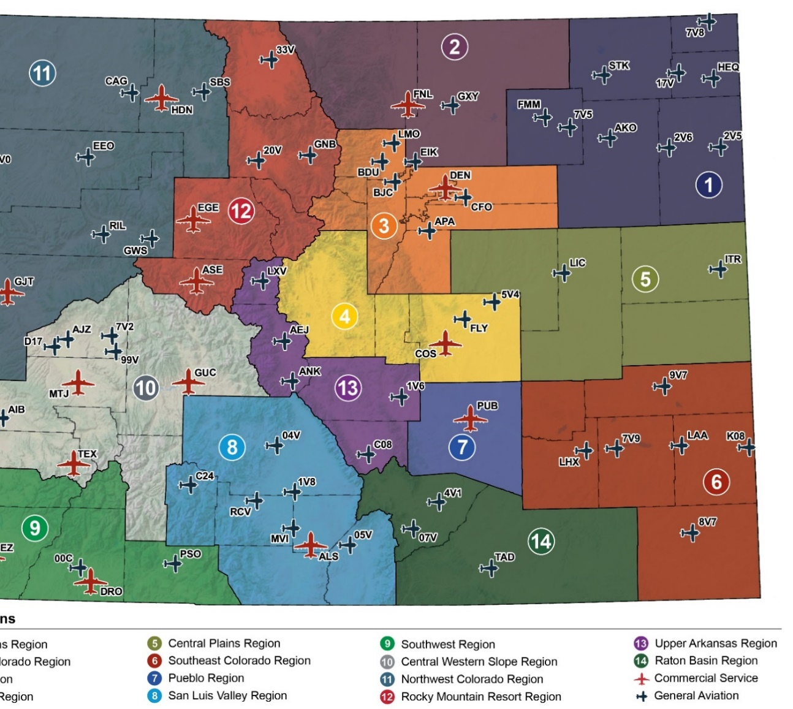
Colorado Office of Economic Development and International Trade (OEDIT) Regions
Notes:
The 14 regions of Colorado’s OEDIT agency were used for the 2020 CEIS. In addition, a unique region was developed for DEN given its size and standing as Colorado’s only large hub airport and the state’s single largest economic generator. Supplier purchases and income re-spending are modeled at both a regional and statewide scale to allow for presentations of regional and statewide impacts for each airport, as well as statewide impacts for the Colorado airport system. Regional impacts of airports consist of the direct impacts plus regional multiplier impacts. Statewide impacts are the same direct impacts plus multiplier effects that reflect an airport’s spending and impact throughout all of Colorado.

Slide 7
Economic Impact Categories
Term | Meaning | Economic Term
Direct | Initial effects that occur on- and off-airport, by spending from visitors and by companies using air transportation services | Direct
Supplier Sales | Portions of direct revenues used to purchase goods and services from Colorado businesses | Indirect
Income Re-spending | Income earned by workers from direct and supplier sales transactions that are then spent in Colorado (household spending) | Induced
Notes:
There are three categories or terms that are used to describe economic impacts and derive the total impacts by airport, region, and for the state. This table presents the three terms or categories used in the 2020 CEIS with their meaning and the industry economic term for reference. When the total economic impacts are presented, they represent the summation of the direct, supplier sales, and income re-spending effects. When examined on the regional level, the supplier sales and income re-spending are on those that occur in the region compared to the state level which identifies the impacts associated with supplier sales and income re-spending of the direct impacts throughout the state.

Slide 8
Economic Impact Measures
Jobs: Jobs are the total number of persons employed, including full- and part-time employees
Payroll: Payroll is defined as total employment compensation, including wages and other benefits (e.g. healthcare insurance payments, retirement contributions, etc.). This is also known as “labor income” or “total compensation”.
Value Added: Value added measures the economic productivity of each aviation-related business establishment, calculated as business revenues earned minus the costs of purchasing goods and services from other businesses. It includes all labor compensation, profits, and business taxes paid.
Business Revenues: Business revenues incorporate expenditures needed to administer airports, sales of goods and services by airport tenants, budget expenditures by public sector agencies located on airports, the cost of capital expenditures, and visitor spending in Colorado’s hospitality-related sectors. This is also commonly referred to as business “output” or sales.
Notes:
The economic impact of airports are expressed in terms of jobs, payroll, value added, and business revenues. These metrics cannot be added to one another, as value added encompasses payroll, and business revenues encompass value added and payroll.

Slide 9
CEIS Terminology Comparison
 | 2013 CEIS Study | 2020 CEIS | OEDIT
Types of Impacts | Jobs/Employment | Jobs | Employment
 | Payroll | Payroll | Labor Income
 | --- | Value Added | Contribution to GDP
 | Output | Business Revenues | Sales
Measures of Impacts | Initial | Direct | Direct
 | Multiplier | Supplier Sales | Indirect
 |  | Income Re-spending | Induced
 | Total | Total Impacts | Total
Notes:
For those familiar with previous Colorado economic impact studies, there was a change in terminology for 2020. This slide provides a comparison or crosswalk of terminology to prior 2013 CEIS and the terminology that was used and is comparable to what OEDIT uses in its economic impact analyses. The terminology was revised from the previous study to be more easily understandable for people who are unfamiliar with economic impact studies. The biggest differences are addition of Value Added as an impact type and the separation of multiplier impacts between supplier sales and income re-spending.

Slide 10
New Term – Value Added
Reports the contribution of businesses and industries to the Colorado State Product (CSP) and the U.S. Gross Domestic Product (GDP)
Represents the true value of aviation to the Colorado economy
Value Added Encompasses:
Wages, salaries, benefits to workers
Profits to Colorado businesses and proprietors’ income
Taxes paid by Colorado businesses
Dividends, interest, rent
Notes:
Added for the first time in the 2020 CEIS, this metric accounts for the value added to a good or service by a business process -- that is, the transformative value of labor to raw materials (and returns to capital) that yields the new value. Employee wages and company profits are included in value added, as those are part of the process of transforming an input into some other good or service. GDP measures the total value added of all final goods and services produced within an economy during that period, whether at the state or national level.

Slide 11
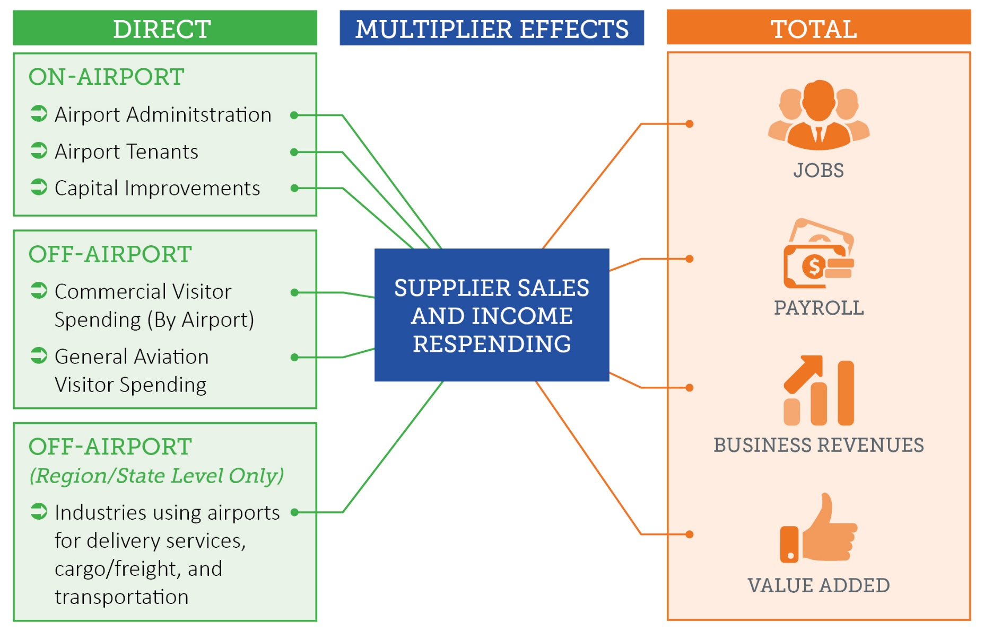
Calculating Total Impacts
Notes:
The total economic impact of airports is the sum of direct impacts and multiplier effects (both supplier sales and income re-spending), the results of which are expressed in terms of jobs, payroll, business revenues, and value added. Direct impacts are generated by three main streams: on-airport business activity, off-airport visitor spending, and industries’ reliance on aviation. The first two streams are analyzed at the airport-specific level. Off-airport business reliance is only analyzed at regional and state levels, due to the inherent challenges of attributing off-airport impacts to a specific airport facility. On-airport activities and off-airport visitor spending are described in more detail in the following slides.

Slide 12
On-Airport Impacts
Airport Administration Airport operations, management, and budget including but not limited to facility and grounds maintenance and other administrative needs.
Airport Tenants Airlines; fixed-base operators (FBOs); maintenance, repair, and overhaul (MRO) providers; aircraft service companies, terminal concessionaires; and other businesses with employees working on-airport property.
Capital Improvements Construction of airside and landside facilities involving airport (local), federal, state, and other funds, as well as tenant expenditures. Total annual expenditures between 2015 – 2018 were averaged to obtain an “average” expenditure year.
Notes:
On-airport impacts are generated by activities conducted by airport administration including owners, managers, and sponsors, as well as on-airport business tenants with employees working on airport property. This stream of impact also includes capital improvement expenditures. Averaging capital improvements over multiple years “smooths out” any years of particularly high or low expenditures to create a profile of an “average” spending year. Additional expenditures were gathered through the airport tenant survey, in which tenants were asked if they had paid for capital improvements such as building out concession space or constructing a hangar. IMPLAN regional relationships between construction revenues and jobs, payroll, and value added were used to develop the full profile of direct impacts resulting from capital expenditures on construction.

Slide 13
Off-Airport Impacts
Visitors (Commercial and GA Spending)
Airports facilitate money from out-of-state being brought into Colorado. Impacts are generated by non-local visitors who arrive by air and spend money off-airport on lodging, retail, restaurants, entertainment, and local transportation.
Notes:
Air visitors arrived by scheduled airline service through one of Colorado’s commercial service airports with service in 2018 and by GA aircraft at all 70 CEIS airports. Commercial Service at Northern Colorado Regional was not available in 2018 so there is not associated commercial service visitor spending at FNL. The visitor spending analysis looks specifically at visitors to Colorado from out of state or international locations, as these travelers bring new money into the state’s economy. The analysis also removes transit passenger who connect through a Colorado airport on their way to another final destination. For example, a visitor connecting through Denver International Airport (DEN) with a final destination at Cortez Municipal (CEZ) will count as a visitor at CEZ. A passenger making a connection through DEN to Helena, Montana will not count as a visitor in Colorado. In both cases, spending by passengers in the DEN terminal is counted in the analysis of concessions.
Spending estimates for visitors using commercial or GA airports were developed through information obtained from airport passenger surveys as well as third-party data providers (such as local/state tourism agencies).

Slide 14
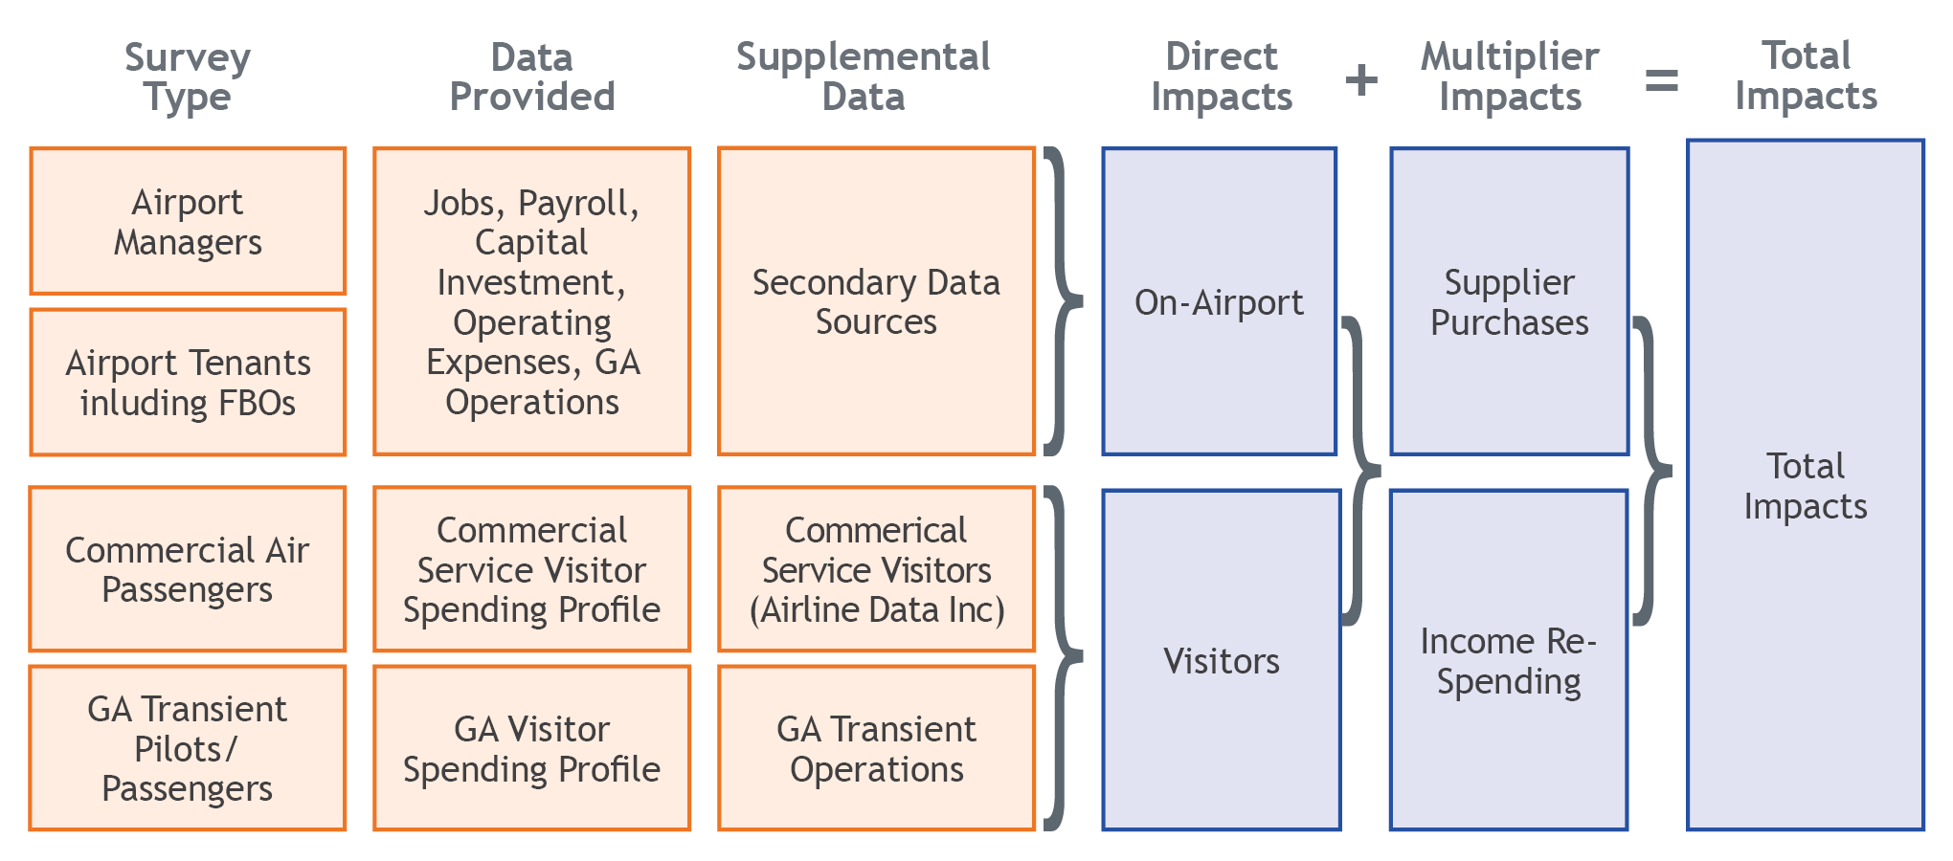
Data Sources and Process Overview
Notes:
The primary data source for this economic impact study was a series of surveys designed to gather key information for activities generating direct on- and off-airport economic activity. When necessary, additional secondary data, including the IMPLAN modeling system, were used to fill in any missing information from the surveys for on- and off-airport business activity and visitor spending.

Slide 15
Economic Impacts of Off-Airport Air Cargo
Analysis documents off-airport impacts supported by air cargo services at airports
Analysis relies on data from a variety of sources including:
U.S. Census Bureau’s Foreign Trade Division (collected by WISERTrade) and the Freight Analysis Framework (FAF)
County-level economic output by industry sectors, assembled by IMPLAN from federal sources (primarily the U.S. Bureau of Economic Analysis [BEA])
Top industries reliant on air cargo include precision instruments and electronics
Notes:
In addition to individual airport economic impacts, the economic impact of air cargo documents the off-airport activities supported by air cargo services at Colorado’s airports. Air cargo’s “off-airport-related impacts” are the business revenues earned due to these long-distance sales, and the subsequent jobs, payroll, and value added attributable to those sales. These impacts are earned by a wide range of manufacturing, agricultural, and other companies who rely on Colorado’s airports to ship products out-of-state.
The analysis used data from several sources regarding air cargo freight and industry sector relationships. The analysis showed that the top Colorado industries that are reliant on air cargo include precision instruments and electronics which rely on air cargo transport outside of Colorado and generate additional economic impacts not quantified at the airport level.

Slide 16
Cargo Tonnage Produced by County
Sources: WISERTrade data from the U.S. Census Bureau Foreign Trade Division; FAF data from the BTS and Federal Highway Administration (FHWA), 2017; IMPLAN modeling system; calculations by EBP US, 2020
Notes:
The air cargo analysis identified Colorado industries at the county level that produce goods shipped through Colorado airports to out-of-state domestic and international destinations, with darker red counties indicating greater tonnage of air cargo flowing out of that county. Located in Denver County and El Paso County, respectively, Denver International Airport (DEN) and Colorado Springs Municipal (COS) support the overwhelming proportion of air cargo shipped out-of-state by Colorado producers, and account for 98.6 percent of direct business revenues earned by state businesses from their exports. DEN, by itself, accounts for almost 94 percent of direct business revenues generated by exports.

Slide 17
Economic Impact Results
Notes:
The following section summarizes the economic impacts of each type of economic impact expressed in terms of jobs, payroll, value added, and business revenues.

Slide 18
TOTAL Statewide Aviation Impacts
$16.2 BILLION
$27.0 BILLION
$48.6 BILLION
345,661
VALUE ADDED
BUSINESS REVENUES
JOBS
PAYROLL
Including off-airport air cargo impacts of $4.4B
Notes:
At the statewide level, the 70 CEIS airports support 345,661 jobs earning $16.2 billion in payroll, contribute $27.0 billion in value added, and generate a total economic output of $48.6 billion. This includes a total off-airport air cargo impact of $4.4 billion.

Slide 19
Comparison of Statewide Study Results
 | Data Year 2013 | Data Year 2018 | Change (#) | Change (%)
Jobs | 265,701 | 345,661 | 79,959 | 30%
Payroll | $12.6B | $16.2B | $3.6B | 29%
Value Added | N/A | $27.0B | N/A | N/A
Business Revenues | $36.7B | $48.6B | $11.9B | 32%
Notes:
Since the CEIS was previously completed in 2013, aviation in Colorado now supports 30 percent more jobs generating 29 percent in additional payroll. In total, the economic output of airports has increased by $11.9 billion representing 32 percent growth.

Slide 20
TOTAL <Airport Name> Impacts
$XX MILLION
$XX MILLION
$XX MILLION
XXX
VALUE ADDED
BUSINESS REVENUES
JOBS
PAYROLL
Notes:
<AIRPORT NAME> created XXX jobs earning $XX (million or billion) in payroll, contributed $XX (million or billion) in value added, and generated a total economic output of $XX (million or billion).

Slide 21
Colorado Airport Economic Impacts — Jobs
<INSERT AIRPORT NAME>
Impact Category | Direct | Supplier Sales | Income Re-spending | TOTAL Jobs
On-Airport | (On-airport direct Jobs) | (On-airport Supplier Sales Jobs) | (On-airport Income re-spending Jobs) | (On-airport total Jobs)
Visitor Spending | (Visitor Spending direct jobs) | (Visitor Spending Supplier Sales Jobs) | (visitor spending Income re-spending Jobs) | (Visitor Spending total Jobs)
Total Jobs | (Direct total jobs) | (Supplier Sales total Jobs) | (Income Re-spending total jobs) | (Total Jobs)
Note: Columns may not add due to rounding
Notes:
The following slides present the individual components of economic impacts of <AIRPORT NAME>. As this slide shows, <AIRPORT NAME> supports xx total jobs generated by on-airport activity and visitor spending.

Slide 22
Colorado Airport Economic Impacts — Payroll (Billions)
<INSERT AIRPORT NAME>
Impact Category | Direct | Supplier Sales | Income Re-spending | TOTAL Payroll (Billions)
On-Airport | (On-airport direct payroll) | (On-airport Supplier Sales Payroll) | (On-airport Income re-spending payroll) | (On-airport total payroll)
Visitor Spending | (Visitor Spending direct payroll) | (Visitor Spending Supplier Sales Payroll) | (visitor spending Income re-spending payroll) | (Visitor Spending total payroll)
Total Payroll (Billions) | (Direct total payroll) | (Supplier Sales total payroll) | (Income Re-spending total payroll) | (Total payroll)
Note: Columns may not add due to rounding
Notes:
<AIRPORT NAME> generates XX in payroll due to on-airport activity and visitor spending.

Slide 23
Colorado Airport Economic Impacts — Value Added (Billions)
<INSERT AIRPORT NAME>
Impact Category | Direct | Supplier Sales | Income Re-spending | TOTAL Value Added (Billions)
On-Airport | (On-airport direct Value Added) | (On-airport Supplier Sales Value Added) | (On-airport Income re-spending Value Added) | (On-airport total Value added)
Visitor Spending | (Visitor Spending direct value added) | (Visitor Spending Supplier Sales value added) | (visitor spending Income re-spending value added) | (Visitor Spending total Value added)
Total Value Added (Billions) | (Direct total value added) | (Supplier Sales total value added) | (Income Re-spending total value added) | (Total Value Added)
Note: Columns may not add due to rounding
Notes:
<AIRPORT NAME> contributes xx in value added. As previously noted, this metric represents the total value contributed by this airport to the state’s GSP.

Slide 24
Colorado Airport Economic Impacts — Business Revenues (Billions)
<INSERT AIRPORT NAME>
Impact Category | Direct | Supplier Sales | Income Re-spending | TOTAL Business Revenues (Billions)
On-Airport | (On-airport direct business revenues) | (On-airport Supplier Sales business revenues) | (On-airport Income re-spending business revenues) | (On-airport total business revenues)
Visitor Spending | (Visitor Spending direct business revenues) | (Visitor Spending Supplier Sales business revenues) | (visitor spending Income re-spending business revenues) | (Visitor Spending total business revenues)
Total Business Revenues (Billions) | (Direct total business revenues) | (Supplier Sales total business revenues) | (Income Re-spending total business revenues) | (Total business revenues)
Note: Columns may not add due to rounding
Notes:
<AIRPORT NAME> contributes xx in business revenues generated by on-airport activity and visitor spending. This metric encompasses payroll and valued added and thus represents the total economic output of <AIRPORT NAME>.

Slide 25
Tax Analysis
Aviation Activities Subject to Taxes
Fuel Sales
Visitors
On-Airport Activities
Rental Cars
Retail
Restaurants
Services
Construction
Airport Administration
On-Airport Businesses
Construction
Visitor Support Businesses
Off-Airport Air Cargo
Retail Sales
Lodging
Food and Beverage
Entertainment
Recreation
Local Transportation
Employees
Notes:
Airports also generate tax revenues to state and local governments from:
Direct activities at commercial service and GA airports
First-round spending by visitors
Multiple rounds of spending generated by supplier sales and income re-spending result in additional revenues to taxing authorities; however, this analysis only looked at direct impacts.

Slide 26
Statewide Tax Analysis Findings
Direct aviation activity in Colorado contributed $1.8 billion in tax revenues to state and local governments in 2018
Notes:
Direct aviation activity in Colorado contributed $1.8 billion in tax revenues to state and local governments in 2018. If multiplier effects, corporate taxes, and property taxes were included, estimates of aviation’s contributions to Colorado’s tax base would be substantially larger. As shown in the chart, 70 percent of impacts were generated by off-airport visitor spending for lodging, shopping, food, and entertainment once they leave the airport. The highest number of visitors arrived through Denver International Airport, which generated 83 percent of all sales and income taxes contributed by Colorado airports.

Slide 27
Tax Impacts for <Airport Name>
Local and State Sales Tax | State Income Tax | Total Direct Taxes
($State sales tax) | ($State income tax) | ($Total direct taxes)
Notes:
The direct tax impacts generated to state and local authorities by <AIRPORT NAME> total $xx in 2018. These consist of local and state sales taxes paid by companies and visitors, including those performing construction at airports, as well as those paid by employees of the airports and/or at visitor establishments. For income taxes, the numbers reflect state income taxes paid by employees engaged in aviation-related activities. The CEIS technical report provides more details on tax impacts by type of activity such as airport tenants, construction, airport administration, and visitor spending.

Slide 28
Additional Aviation Benefits

Slide 29
Agriculture
Impact Type | Jobs | Payroll ($Millions) | Value Added ($Million) | Business Revenues ($Millions)
Direct impact | 1,630 | $52.3 | $77.6 | $431.5
Supplier sales | 2,470 | $113.8 | $176.2 | $284.6
Income re-spending | 1,040 | $50.4 | $91.7 | $156.7
Total Contribution | 5,140 | $216.6 | $345.6 | $872.8
Source: Calculations by EBP US using the 2017 IMPLAN model, 2019
Major Colorado Crops
Corn
Wheat
Alfalfa
Potatoes
Oats
Although DEN is a major international airport, it also utilizes its 53-square-mile footprint to support more than 15,000 acres in on-site farming. DEN has agricultural leases with three families that grow several crops including wheat, corn, millet, and sunflowers.
The estimated of value of crops treated by aerial spraying in 2018 was $657.4 million.
Notes:
Aerial application significantly contributes to Colorado’s $7.5 billion agricultural industry in three ways:
Preserves cropland value by preventing surface disruption associated with tractors.
Supports Colorado industries by employing pilots and enabling crop production.
Increases crop production yields efficiently and cost-effectively.
The total contribution of aerial spraying to the Colorado state economy—including jobs associated with aerial-treated crops and jobs in aerial application—amounts to over $870 million in annual business revenues and 5,140 jobs. These jobs generate $216.6 million in annual payroll and contribute $345.6 million to the state’s GDP.

Slide 30
Airport Stories
Notes:
Airports contribute to Colorado’s quality of life, safety, security, and resiliency in ways that can never be captured in dollars. The 2020 CEIS and Colorado Aviation System Plan identified more than 20 real-life examples of how unique aviation programs, organizations, and activities support residents of Colorado and aviation users around the globe. These are documented in stories summarized by topic, individual airport reports, as well as throughout the CEIS and CASP technical reports.

Slide 31
<Airport Name> Users/Stories
Can add information on specific users or activities that contribute to the airport
Can add pictures or other images
Notes:
Airport to tailor to their specific users/stories.

Slide 32
Project Website
https://www.coloradoaviationsystem.com/
Notes:
The final study documents for both the 2020 CEIS and Colorado Aviation System Plan are available online at www.coloradoaviationsystem.com. The website also includes individual airport brochures that can be download for all airports included in the scope of the study.

Slide 33
Contact
Scott Storie
Aviation Planner / Project Manager
P: 303.512.5250
E: scott.storie@state.co.us
David Ulane
Aeronautics Director
P: 303-512-5254 E: david.ulane@state.co.us

